Slide 1
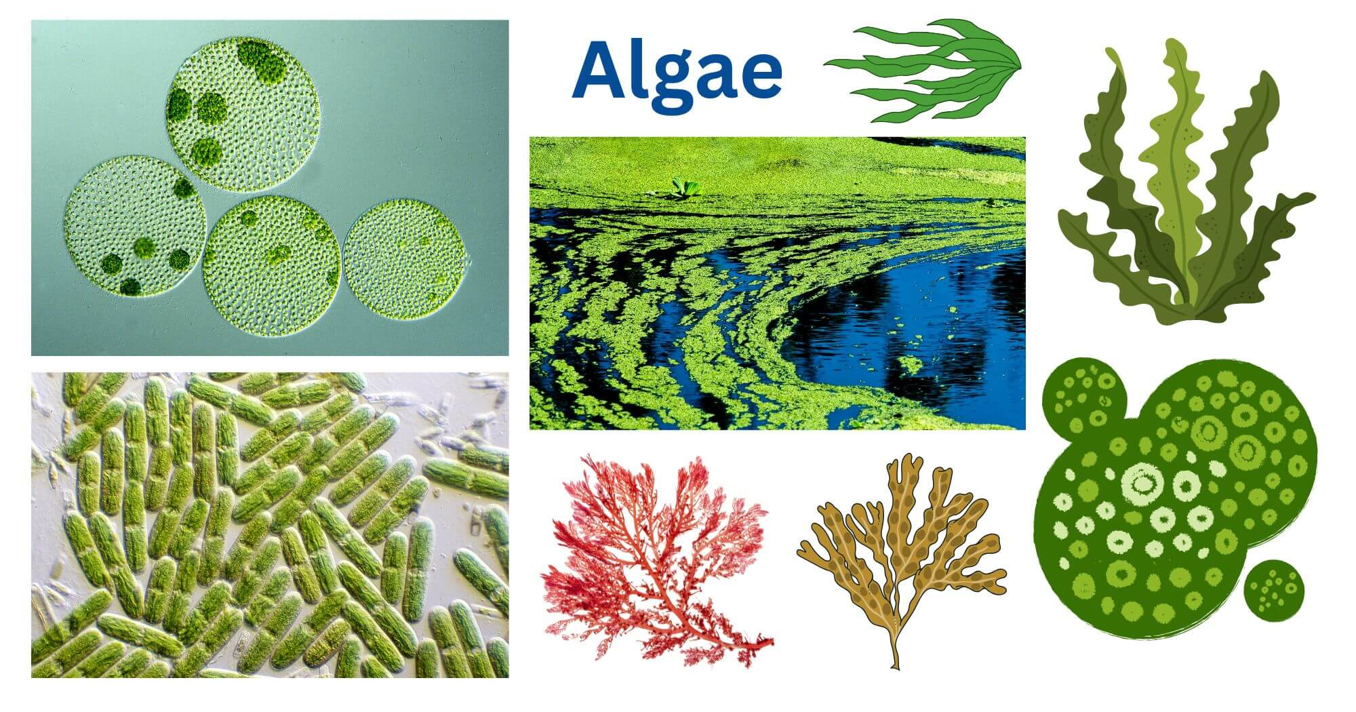
Thallus Organization in Algae
Dr. Trilok Kumar
Assistant Professor
Govt. Digvijay Autonomous PG College, Rajnandgaon, C.G.

Slide 2
Thallus Organization in Algae
Algae is a Heterogenous group of plants having a wide range of thallus organization.
Thallus ranges from unicellular to multicellular.
On the basis of BODY PLANE algae may be divided into 6 groups:
Unicellular
Coenobial
Colonial or Aggregates
Filamentous
Siphonaceous
Advanced thallus.

Slide 3
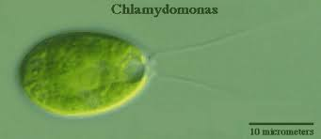
Thallus Organization in Algae
Unicellular Thallus: Simplest algae, Unicellular, may be motile, non- motile or amoeboid.
Types: 3 types
Motile unicellular thallus: having 2 anterior flagella for locomotion and movement.
e.g. Chlamydomonas etc.

Slide 4
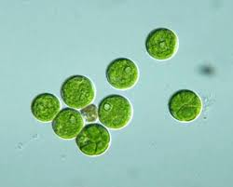
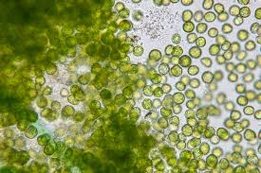
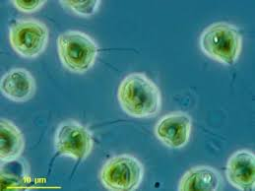
2. Non-motile Unicellular thallus: Also known as Coccoid type thallus. Flagella not present.
e.g. Chlorella, Chlorococcum etc.
Chlorella Chlorococcum
3. Amoeboid unicellular thallus: This group of algae contains some amoeboid cells which are attached with thallus as cytoplasmic projections.
eg: Chrysamoeba: A genus of chrysophyte algae (golden algae) that lack flagella and exhibit characteristic amoeboid movement.

Slide 5
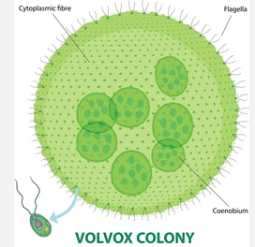
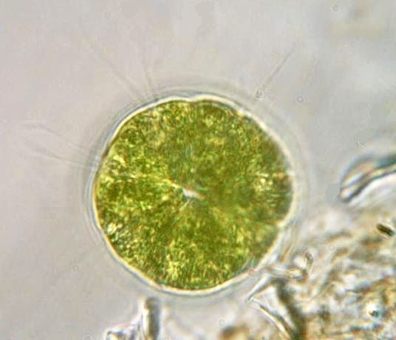
Thallus Organization in Algae
(B) Coenobial Thallus:
Coenobium is a multicellular colonial plant body. Number of cells in a coenobia is usually in multiple of two.
Types: 2 types
Motile or Flagellted Coenobia: having flagella. Coenobia are motile.
e.g. Volvox, Pandorina etc.
Pandorina

Slide 6
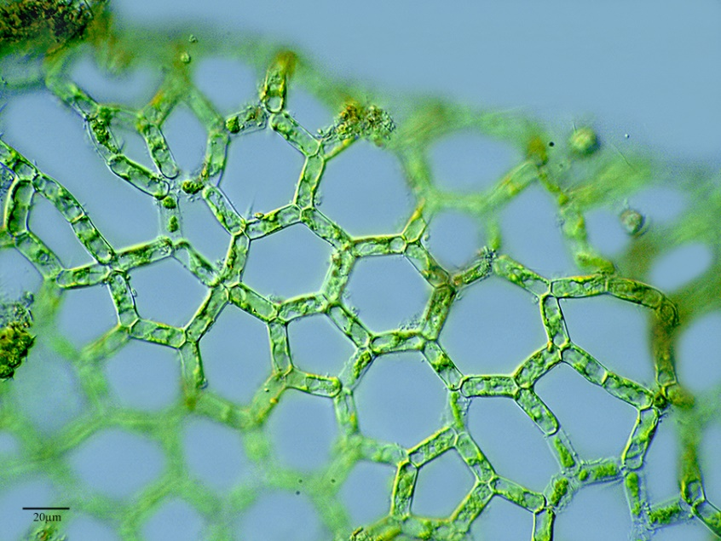
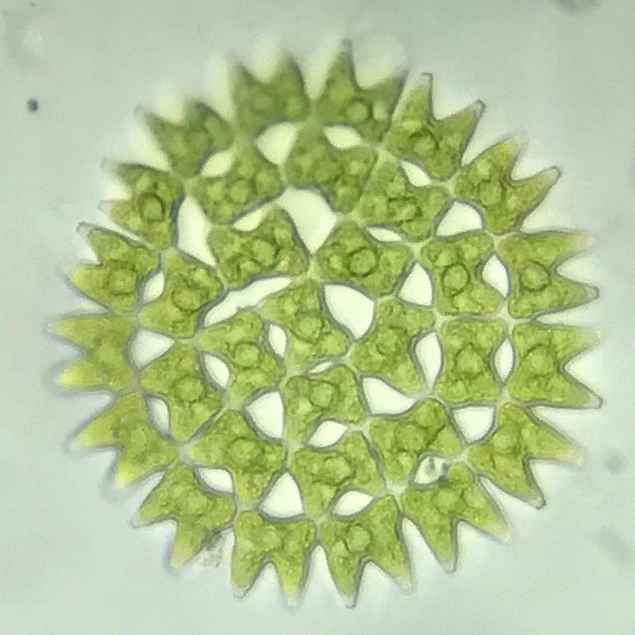
2. Non-motile Coenobia: Coenobia are non- flagellated and fuse together.
e.g. Hydrodictyon, Pediastrum etc.
Hydrodictyon
Pediastrum

Slide 7
Thallus Organization in Algae
(C) Colonial or Aggregate Thallus:
Many of the green algae have thallus consisting of a loose assemblage of cells held together with a gelatinous envelop. It is known as colony. They differ from coenobia in following respects:
They divide vegetatively.
The number of cells increasing during growth.
The shape of colony is definite.
Types: 3 types: 1. Palmelloid colony
2. Dendroid
3. Rhizopodial

Slide 8
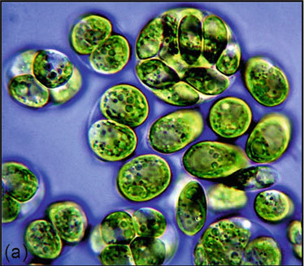
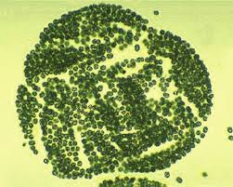
Palmelloid colony: The cells of this group of algae are covered with mucilaginous or gelatinous sheath. Palmelloid algae having no definite or fixed no. and size of cells. This form is formed during adverse environmental conditions. e.g. Chlemydomonas, Microcystis etc.
Chlemydomonas
Microcystis

Slide 9
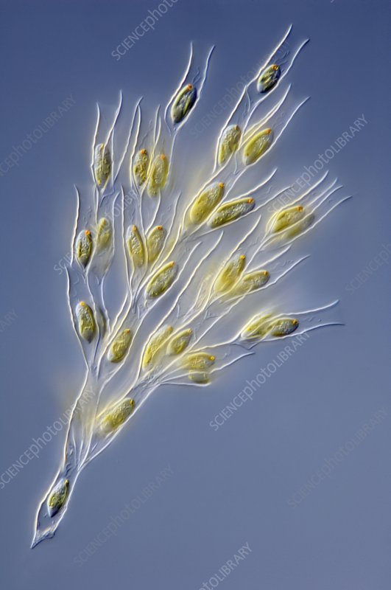
2. Dendroid colony: It is a multicelluar colonial form in which cells become joined at a specific place due to mucilage formation and form a tree like structure.
e.g.: Dinobryon divergens, Prasinocladus etc.
Dinobryon divergens

Slide 10
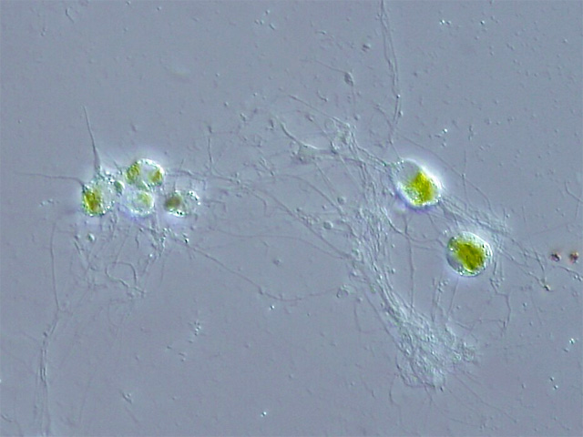
3. Rhizopodial colony: A colony in which the individual cells are linked together by rhizopodia is called rhizopodial forms or rhizopodial colony.
e.g.: Chlorachnion
Chlorachnion

Slide 11
(D) Filamentous forms:
An algal thallus cells are arranged in linear row.
All cells are joined end to end. It is called a filament or filamentous form.
On basis of no. of rows of filaments: 2 Types
Uniseriate filament.
Multiseriate filament

Slide 12
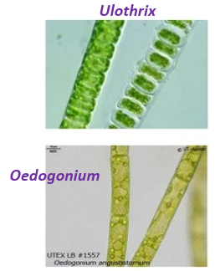
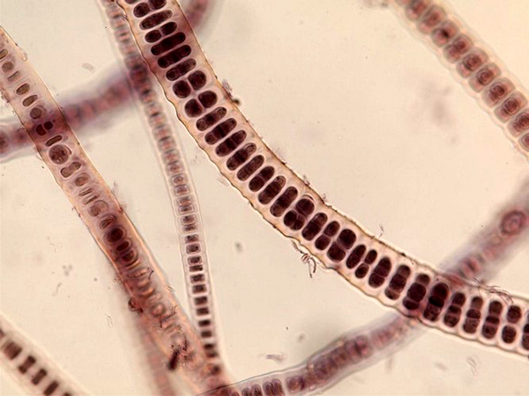
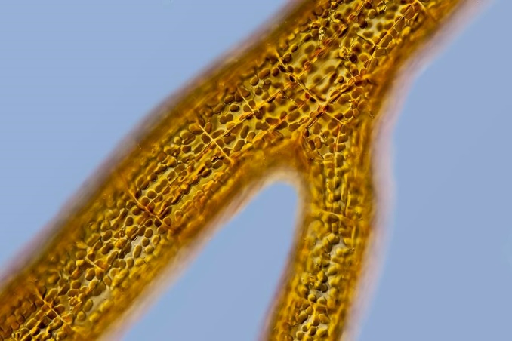
Uniseriate filament – The filament is made of single row of cells.
e.g. Ulothrix, Oedogonium
2. Multiseriate filament – The cells are arranged in more than one linear row.
e.g. Bangia (red algae) Sphacelaria (brown algae)

Slide 13
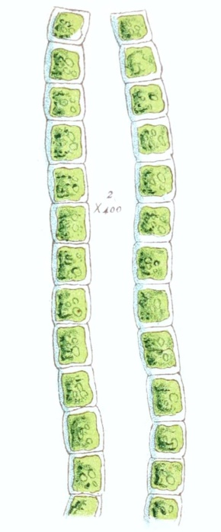
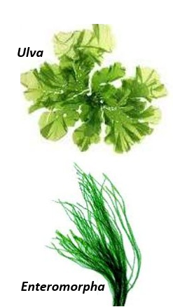
On basis of branching:
The filamentous forms are of two types:
Unbranched
Branched
(i) Unbranched types –
Simple with linear row of cells
e.g. Ulothrix
Leaf – like e.g. Ulva
Tubular –like e.g. Enteromorpha
Ulothrix_aequalis

Slide 14
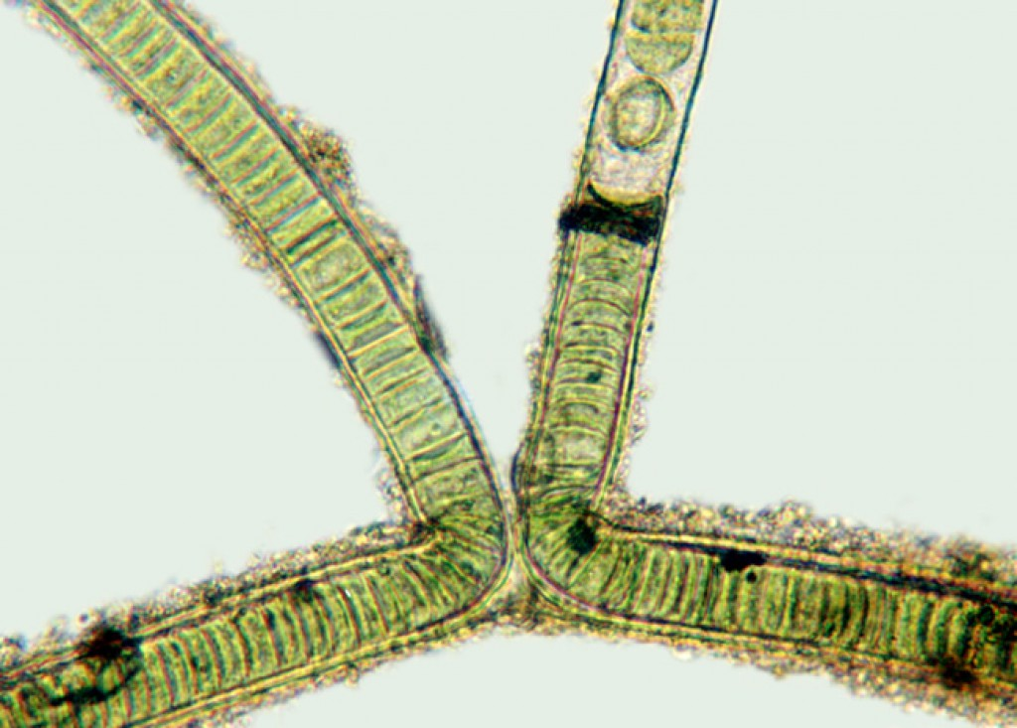
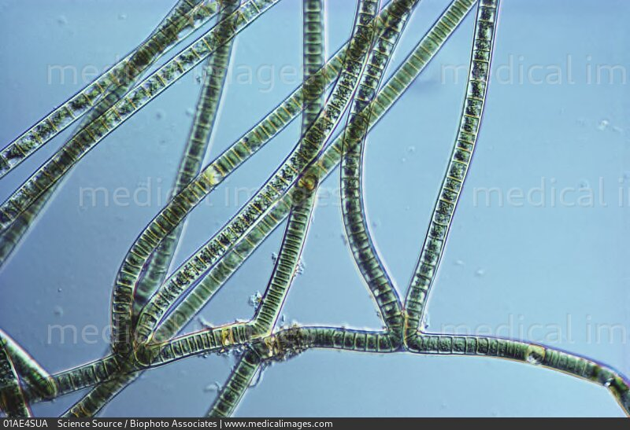
Branched filamentous:
Filamentous thalli with lateral branches is called “branched filaments algae”.
Types of branched thalli:
Pseudo branches
• In some algae, the filaments breaks at certain points due to the disintegration of cells.
• The cells adjacent to the dead cells grow out of the mucilaginous sheath called “Pseudo branches”
e.g.: Scytonema
Scytonema

Slide 15
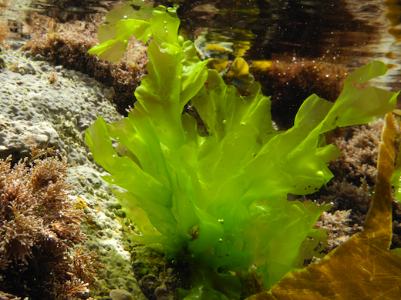
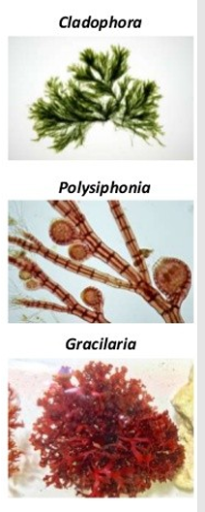
b. True branched:
The lateral branches arise due to the transverse division of cells in lateral outgrowths.
Parenchymatous cells: True cell.
e.g. Ulva
Pseudoparenchymatous cells: Pseudo. Cells are actually formed by the dense interweaving and fusion of filaments. e.g. Cladophora, Polysiphonia, Gracilaria
Ulva

Slide 16
Heterotrichous forms:
Hetero – different; trichous – filament
The thallus of this group of algae is much branched and form two types of branches.
• The filaments which contains both prostrate system and erect system is called “Heterotrichous form”.
• The thallus are differentiated into creeping system and projecting system.
• Prostrate/ Creeping system – consists of branched filaments attached to the substratum.
• Erect/Projecting system – arises from the creeping system and grows erect.
e.g. Frischiella, Coleochaete, Drapernoldiopsis

Slide 17
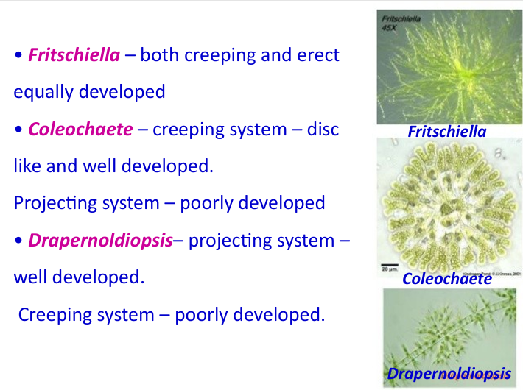

Slide 18
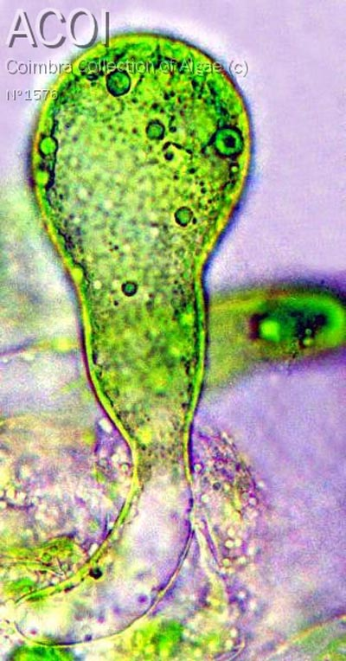
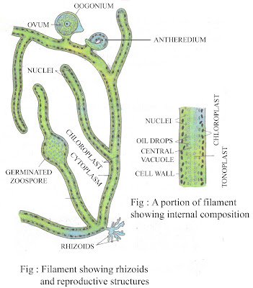
(E) Siphonous algae or Ceonocytic algae :
Elongated thallus without septation.
The thallus cell is elongated which contains many nuclei, chromatophores, cytoplasm and a central narrow vacuole.
Eg. Vaucheria and Protosiphon
Protosiphon

Slide 19
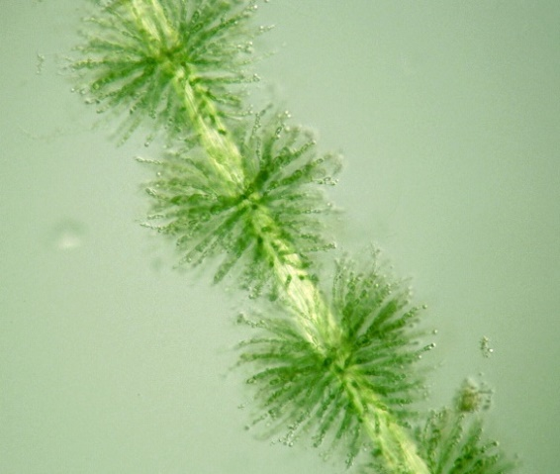
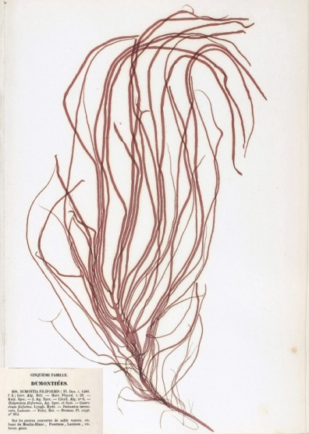
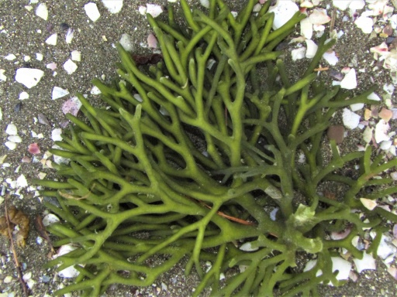
(F). Advanced Thallus:
The thallus of this of group is septated or non-septated. It is of three kinds:
Uniaxial: In this type, the single main axial thread (Filament) has close branch system to form more or less compact thallus.
e.g. Batrachospermum, Dumontia etc.
2. Multiaxial: In this group, there is a number of axial filaments and branches and all of them together to form a complex structure.
e.g. Codium
Batrachospermum
Dumontia_contorta
Codium

Slide 20
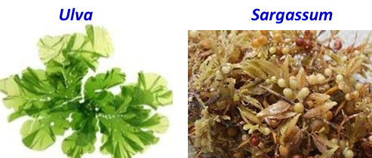
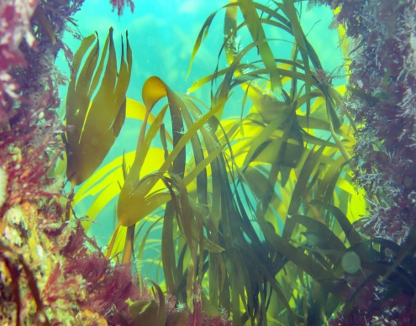
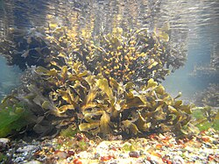
3. Parenchymatous forms:
The plant body of algae made up of parenchyma cells.
During the cell division septation leads to the formation of a parenchymatous body.
E.g.- Ulva, Sargassum, Lamineria, Fucus etc.
Lamineria Fucus

